Slide 1
Chemistry 115 Lab

Slide 2
Safety Rules
Do not engage in horseplay in the lab at any time. It will not be tolerated for any reason.
Do not perform any lab work without your instructor present. This includes working on experiments, using lab glassware, and/or using reagents and lab chemicals. You may work on lab reports, graphing, or study in the lab without the instructor’s presence.
In order to make up an experiment you must first obtain the approval of your instructor. You must then obtain the permission of the instructor in whose lab you wish to work. Finally, you must inform the stockroom technicians.

Slide 3
Safety Rules
You must wear approved eye protection at all times when anyone is doing lab work. You must wear closed toe shoes (not sandals) to protect your feet against broken glass and spilled reagents. We recommend that you wear a lab apron or old clothing.
In case of injury, fire, or other mishap, inform the instructor at once. If the instructor is not in the immediate area inform the chemistry technician in the stockroom.

Slide 4
Safety Rules
Do not put anything in your mouth while in the lab. You are not allowed to eat, drink or smoke in the lab.
Use a fume hood in order to avoid prolonged contact with noxious vapors or poisonous gases.
Immediately use water to rinse off corrosive chemicals from your skin or eyes. Notify an instructor. Wash your hands before leaving the lab for the day. Some chemicals can be readily absorbed through the skin.

Slide 5
Safety Rules
Use a lubricant such as glycerine to insert glass tubing or a thermometer into a rubber stopper. Hold the piece of glass which is being inserted or removed close to the end with a paper towel.
Clean up spills and breakage immediately. Neutralize acids or base spills with sodium bicarbonate before washing down the area with water.

Slide 6
Safety Rules
Familiarize yourself with the safety equipment in the lab, including the first aid kit, fire blanket, fire extinguisher, the safety shower, and the eye wash station.
When heating the contents of a test tube, point the open end of the tube away from everyone. A vapor pocket may form beneath the surface of the contents and cause their ejection (bumping).

Slide 7
Safety Rules
Dispose of insoluble waste in the waste basket, not in the sink. Broken glass is to be disposed in the broken glass receptacle.
Be sure to read the labels on all chemical reagent containers before using their contents. Using an improper reagent for an experiment can lead to a serious accident.

Slide 8
Safety Rules
Do not take chemical reagent containers to your work bench. Leave them at their initial location. Do not use any of your lab equipment to dispense chemicals for an experiment. The instructor will demonstrate the proper method for dispensing chemicals.
Chemicals are expensive items therefore, transfer out only what you will need for the experiment. Do not ever return used or excess chemicals to their original containers to prevent contamination.

Slide 9
Safety Rules
At the conclusion of your lab period thoroughly clean up your work area. Make sure that the gas to the bunsen burner is shut off. Do not remove any chemicals or lab equipment from the laboratory.

Slide 10
Lab 1
Exponential Notation and Scientific Notation

Slide 11
Scientific Notation
All numbers written as
C x 10e
where
C is a number between 1 and 10
e is a whole number exponent that identifies the position of the decimal

Slide 12
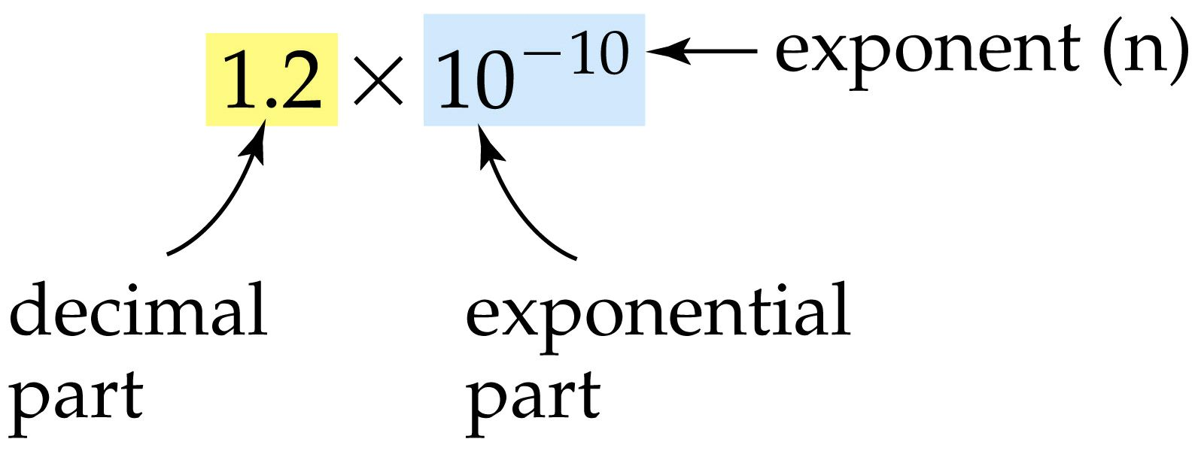

Slide 15
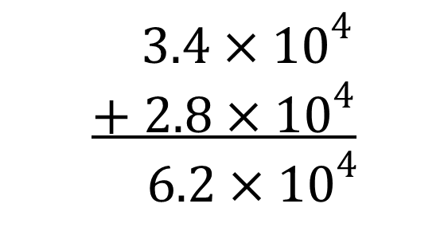
Adding Numbers in Scientific Notation
If Exponents are the same, add the numbers and keep same exponent.
$$3.4×{10}^{4}$$
$$+ 2.8×{10}^{4}$$
$$6.2×{10}^{4}$$
$$6.47×{10}^{−2} → 6.47×{10}^{−2}$$
$$+ 3.1×{10}^{−3} → 0.31×{10}^{−2}$$
$$6.78×{10}^{−2}$$
If Exponents are different, change them to match and add.

Slide 16
Multiplying Numbers in Scientific Notation
$$\left(3.5×{10}^{4}\right)\left(4.6×{10}^{27}\right)$$
$$=\left[\left(3.5\right)×\left(4.6\right)\right]×{10}^{\left(4+27\right)}$$
$$=16.1×{10}^{31}$$
For multiplication:
Multiply the numbers
And add the exponents.

Slide 17
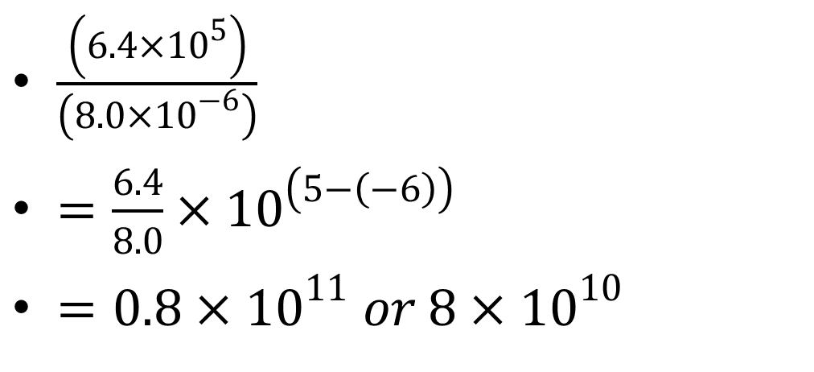
Dividing Numbers in Scientific Notation
$\frac{\left(6.4×{10}^{5}\right)}{\left(8.0×{10}^{−6}\right)}$
$=\frac{6.4}{8.0}×{10}^{\left(5−\left(−6\right)\right)}$
$=0.8×{10}^{11} or 8×{10}^{10}$
And subtract the exponents.
For division:
Divide the numbers
The number may need to be adjusted so it is correctly written in scientific notation

Slide 18
Logs
The log of a number is defined as what you would need to raise 10 to to get the number back.
For example
Log 10000000 = 7
That means that if you take 10⁷ you get the number back!

Slide 19
Logs
To get logs on your calculator
Log 423.53 = 2.6269
two methods depending on your calculator
type 423.53 and hit the log key
hit the log key, type 4.23, and enter or =

Slide 20
logs
To get antilogs on your calculator
Antilog 2.6269 = 10^{2.6269} = 423.53
To get this on your calculator try one of the following--
Type 2.6269, 2nd or inv key, followed by log(10^{x}) key
Press 2nd or inv key, followed by log(10^{x}) key and 2.6269

Slide 21
Precision and Accuracy
Accuracy -- Refers to how close to the true value a given measurement is.
Precision -- Refers to how well a number of independent measurements agree with one another.

Slide 22
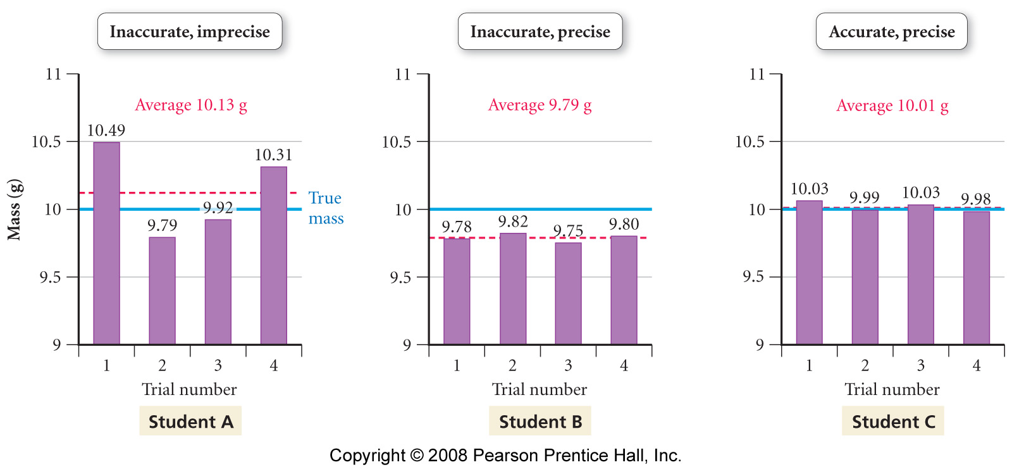
Notes:
Figure: 01-14-08
Title:
Precision graphs
Caption:
Measurements are said to be precise if they are consistent with one another, but they are accurate only if they are close to the actual value.

Slide 23
Significant Figures
The number of digits that are known accurately plus the doubtful digit for a measurement.

Slide 24
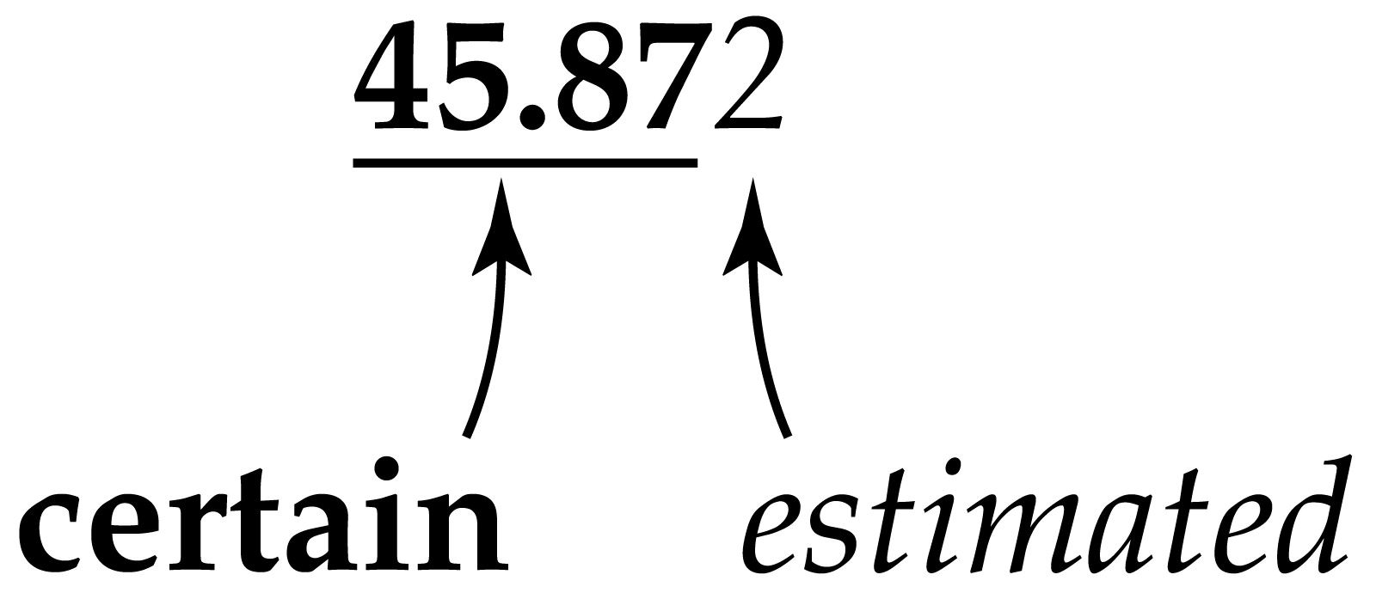

Slide 25
Significant Figures
All non-zero digits are significant.
All zeros between nonzero digits (or significant zeros) are significant.
Zeros used as placeholders are not significant.
all zeros to left of 1st non-zero digit are not significant. (For example 0.0068 -- two sig figs the zeros are placeholders.)
for numbers greater than 1, zeros to the right of last digit are ambiguous if no zeros after decimal point. Assume not significant for this class.
Zeros after last digit are significant for numbers <1 or if they occur after decimal point for number >1.

Slide 26
Exact Numbers
Exact numbers have an unlimited number of significant figures.
1 dozen = 12 = 12.00 = 12.00000000

Slide 27
Calculations with Significant Figures
In addition and subtraction, the last digit retained in the sum or difference is determined by the position of the first doubtful digit.
For example 37.24 1002.46
+ 10.3 + 6.3
------------- ---------------
47.54 1008.76
Rounds to 47.5 1008.8

Slide 29
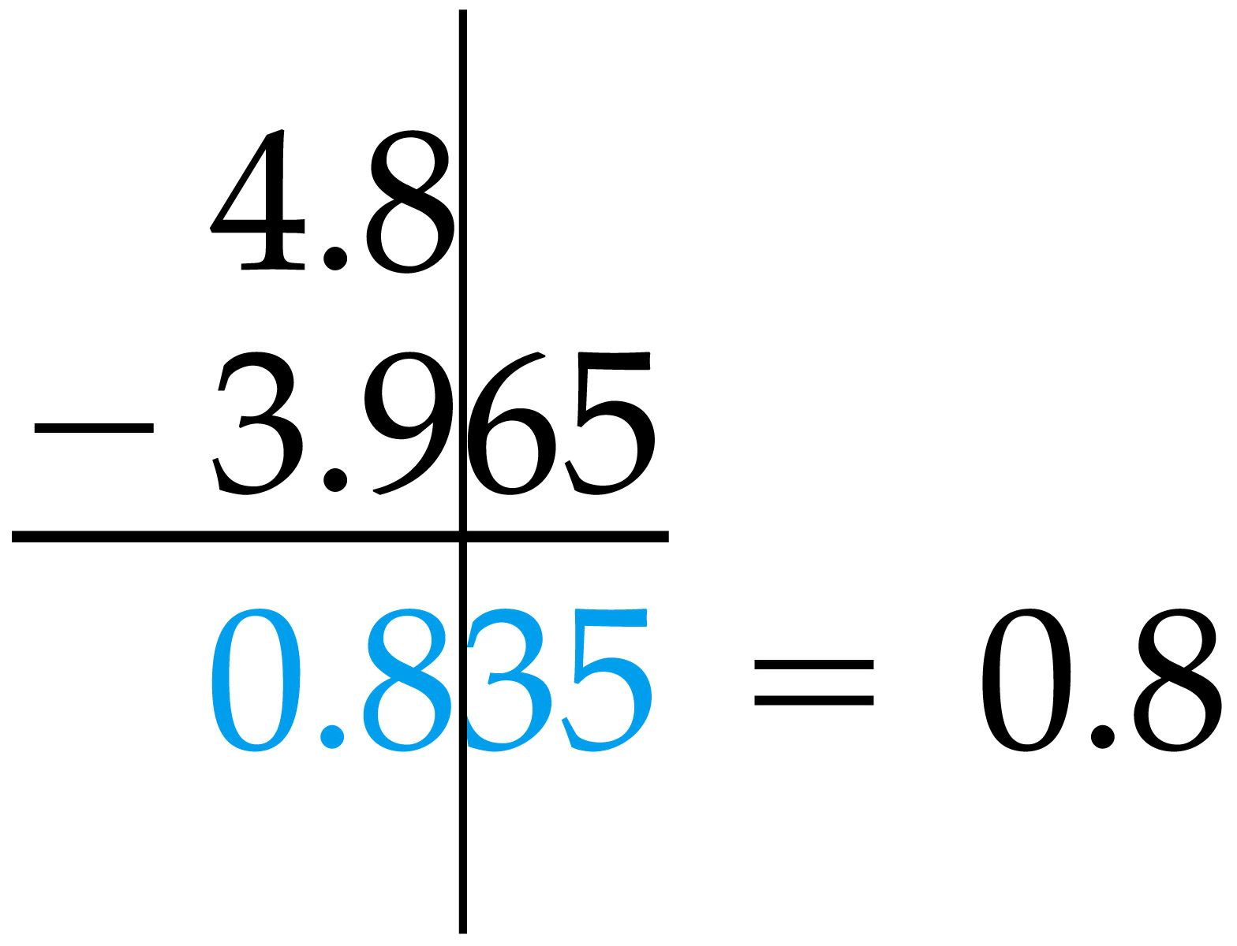

Slide 31
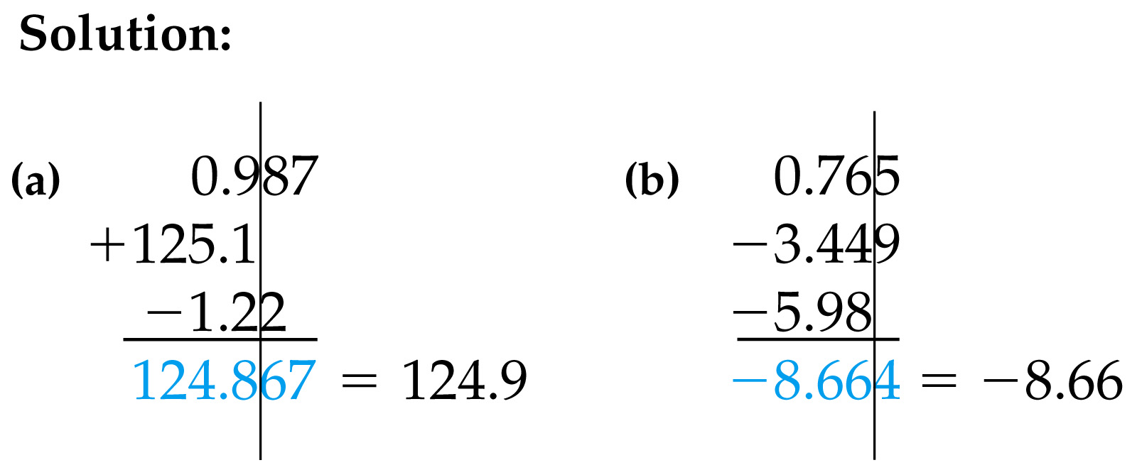

Slide 32
Calculations with Significant Figures
In multiplication and division, an answer has no more sig figs than the measurement with the least number of sig figs.
For example 3.427 x 0.00692 = 0.02371484 = 0.0237

Slide 33
Summary
In multiplication and division, an answer has no more sig figs than the measurement with the least number of sig figs.
In addition and subtraction, the last digit retained in the sum or difference is determined by the position of the first doubtful digit.
When working with exact numbers, measured values determine the number of significant figures.
When rounding off nonsignificant digits round up for 5 and higher, otherwise round down.

